Slide 1




Water Energy Nexus
the interconnected nature of water and energy
AABE - February 2020 Webinar

Slide 2
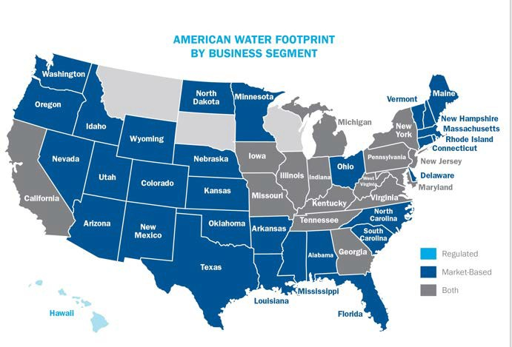
Who We Are
Founded in 1886
Largest and most geographically diverse publicly traded water and wastewater service provider in the United States
Local water company serving over 1,600 communities.
Employ over 6,800 people
Treat and deliver more than a
billion gallons of water daily

Slide 3




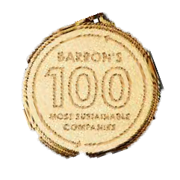
















Doing Well by Doing Good
Notable ESG related indexes
Awards and Recognitions
American Water ranked #22 on Barron’s 100 Most Sustainable Companies
American Water recognized among the top 100 Best for Vets employers by Military Times
American Water Honored by Forum of Executive Women as a Champion of Diversity
American Water earns 2020 Military Friendly® Gold Employer designation
American Water Earns Top Score on Disability Equality Index and listed among “Best Places to Work for Disability Inclusion”
American Water employees log over 5,000 volunteer hours across U.S. during month of service
American Water earns 2020 Military Friendly® Spouse Employer designation
Indiana American Water Wins American Water Works Association’s Wendell R. LaDue Utility Safety Award
American Water Joins Army Representatives to Accept U.S. Department of Energy Award
American Water ranked #16 on Corporate Knights’ Global 100 Most Sustainable Corporations
West Virginia American Water’s Weston Water System Wins 1st Place in the WV- AWWA Tap Water Taste Test
American Water Awarded LEED Platinum Certification for new Corporate Headquarters in Camden, NJ
For American Water, Business As Usual
3

Slide 4
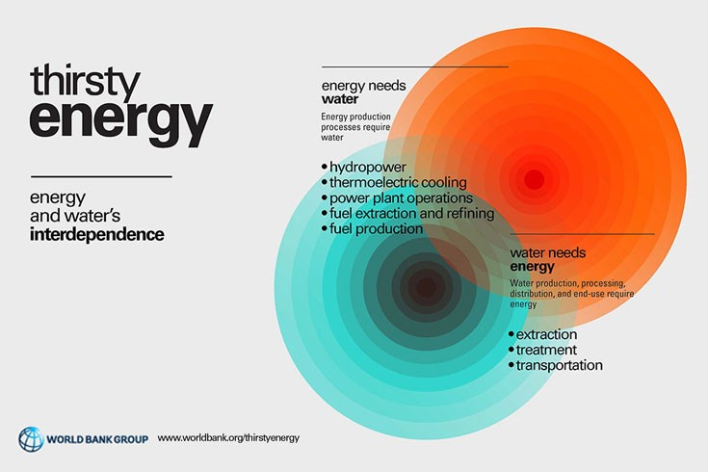
Water + Energy Resources Keep Communities Vibrant and Resilient
Topics
What is the Water + Energy Nexus
Why is it important to water utilities
How can public policy support innovation in the Water + Energy Nexus

Slide 5



















The Water + Energy Nexus Can Help Achieve Shared Goals
Challenges Solutions
Protection of natural resources
Efficient use of natural resources
Enhance community resiliency
Adapt to changing landscape

Slide 6


How Much Electricity Does the Water Industry Use?
Drinking water and wastewater consume:
  2% of domestic electricity¹
  7% of worldwide energy²
Running the hot water faucet for 5 minutes uses about the same amount of energy as burning a 60-watt bulb for 14 hours.³
Electricity Usage and Management in the Municipal Water Supply and Wastewater Industries. (EPRI & WaterRF 2013)
The Connection: Water Supply and Energy Reserves (Dr. Allan R. Hoffman. USDOE)
USEPA

Slide 7
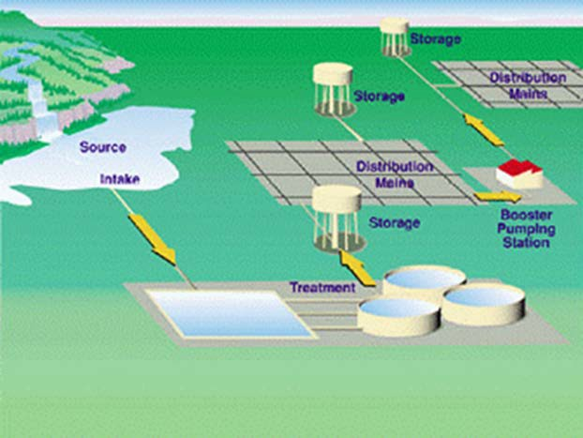





Largest Energy Use in Potable Water Systems
Booster Pump Stations
Raw Water from Source
80% – 90% of typical water utility’s total energy consumption is used to:
Pump Water
Average person uses:
70 gallons of water per day
= almost 600 lbs per day
Treated Water
to System
Treatment Plant Pumping
7

Slide 8
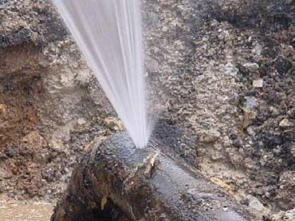
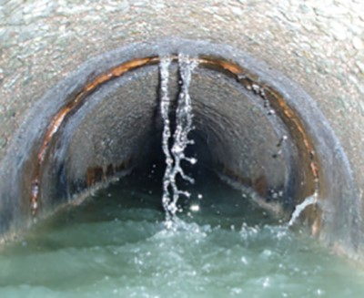
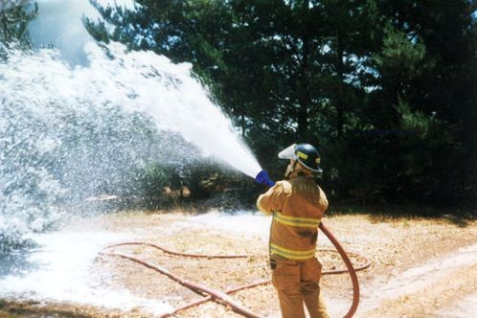
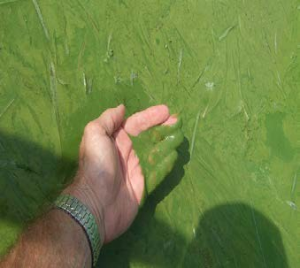
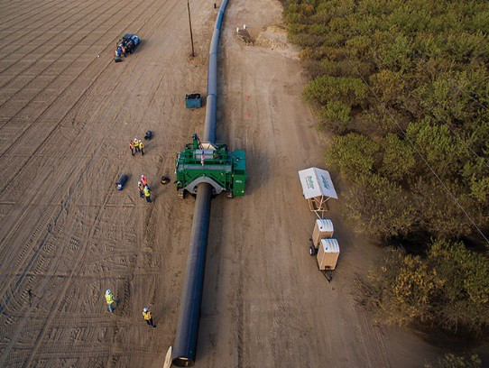
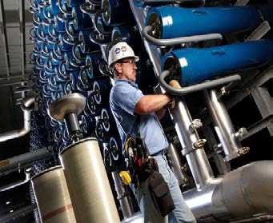
Challenges to Reducing Water’s Energy Needs
Aging infrastructure
  Drinking water leakage
  Sewer system I&I
Emerging contaminants of concern and additional treatment required for lower quality supplies
Increasingly stringent discharge water quality standards
Increasing demands and “competition” for sources of supply
Extreme weather events impacting power

Slide 9
Extreme Weather Events -Increasing Frequency and Magnitude of Events

Slide 10

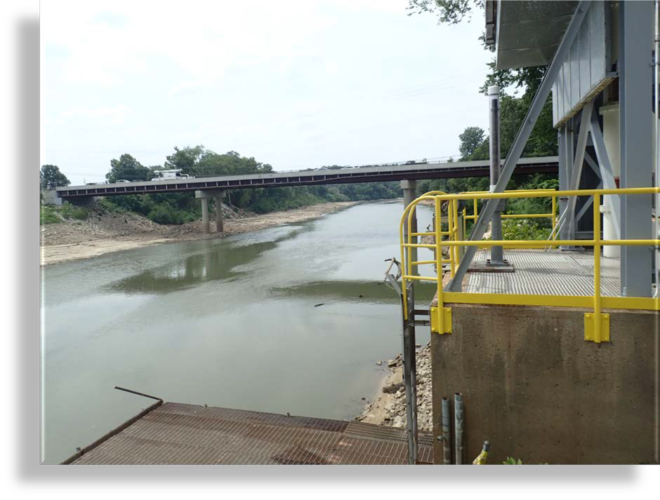
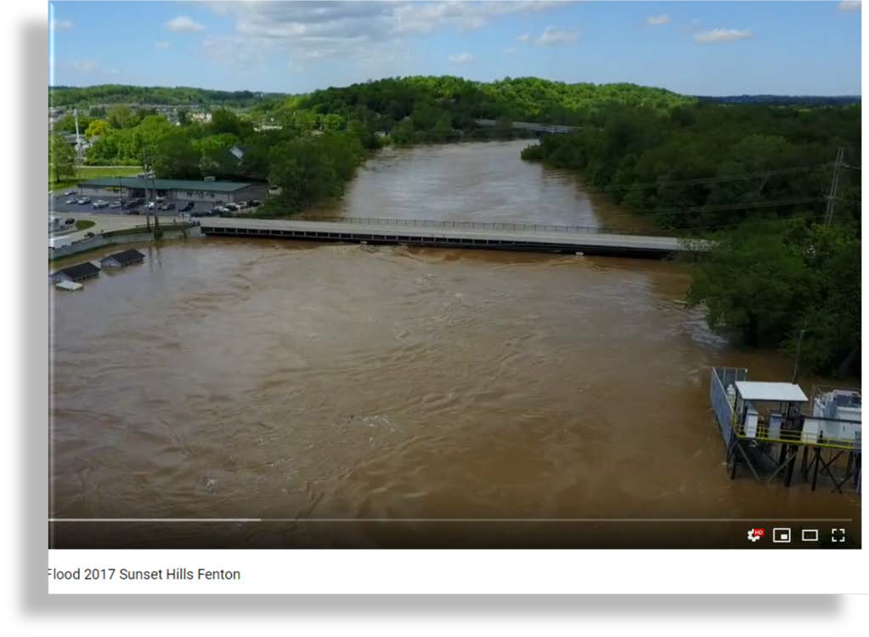
Variability in Same Year – Meramec River, Missouri
2017
https://www.youtube.com/watch?v=_cMs4ZNCmH8

Slide 11


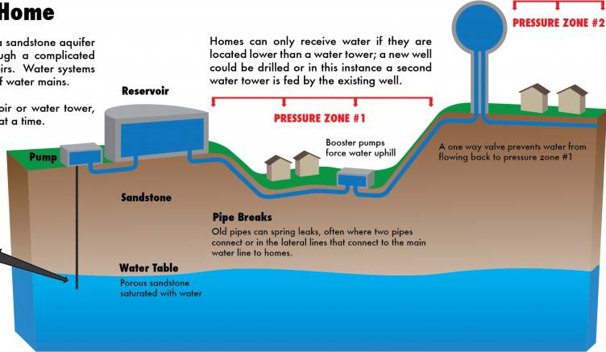
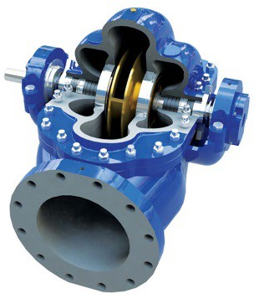
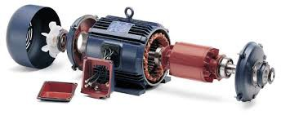
What Can Water Utilities Change to Lower Electricity Use?
Power ≈ (Flow x Pressure) ÷ Efficiency
Flow Rate (Q) – Pump less water
  Decrease leakage
  Decrease demand – help customers use water more efficiently
Pump Head (h) – Pressure Management
  Decrease pressure in localized areas where possible
Pump Efficiency (η) – Pump more efficiently
  Increase pump hydraulic efficiency
  Increase motor and drive efficiency
11

Slide 12
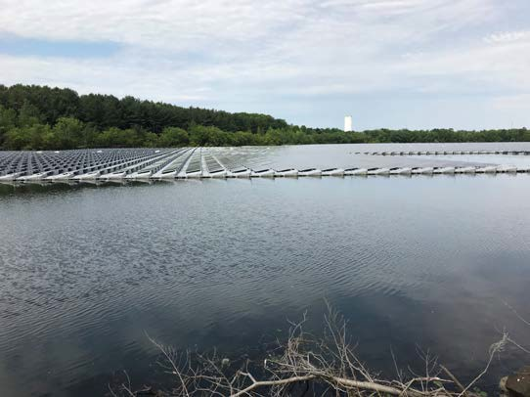
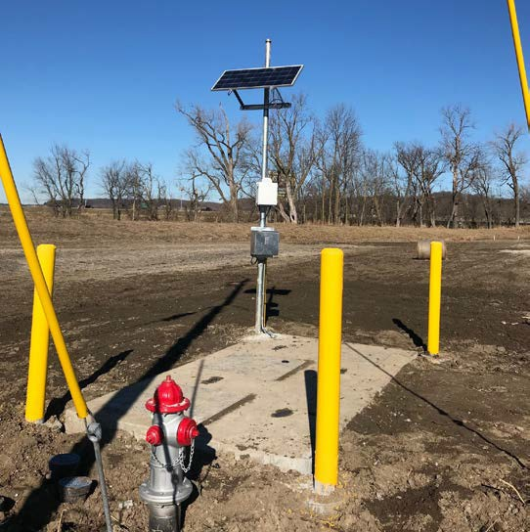
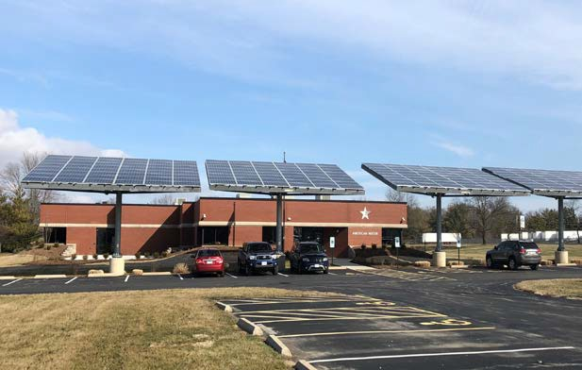
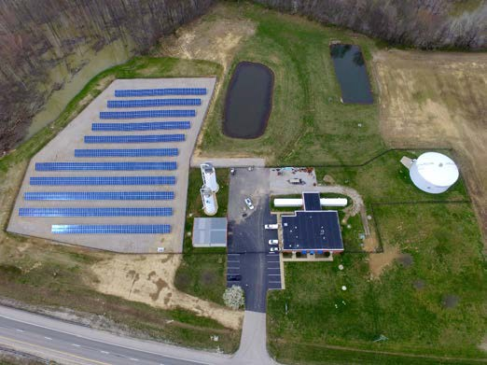
Solar PV at American Water
13 major installations
In 5 states
~3.9 MW installed capacity
Open to more!

Slide 13
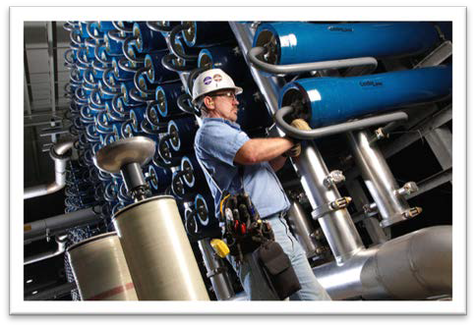
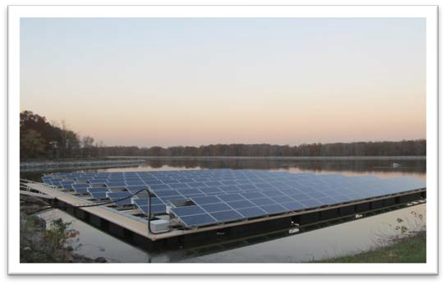
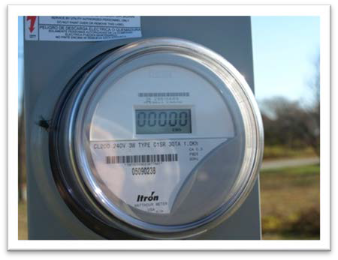
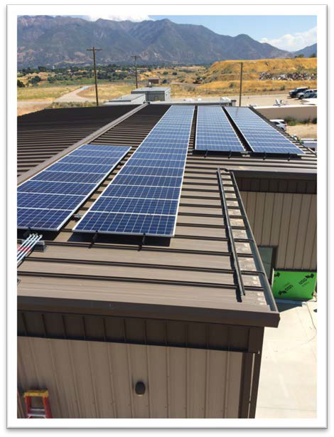
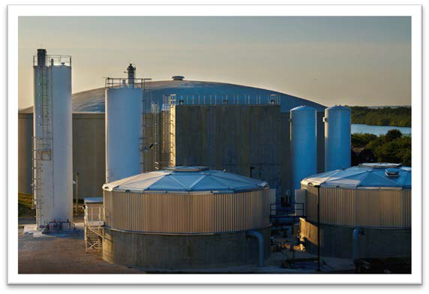



Incorporating Sustainability into Operations
Desalination
Anaerobic Digestion
Solar & Geothermal
Flood Protection & Generators
Building Designs toward Net Zero
Certified Safe Worker
Certified Environmental Leader

Slide 14
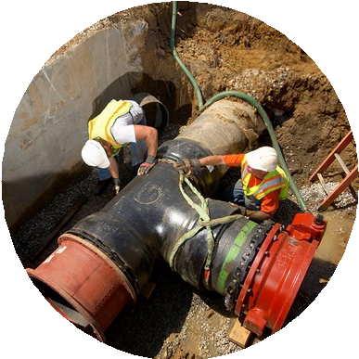
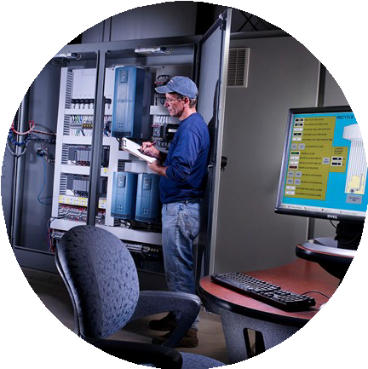
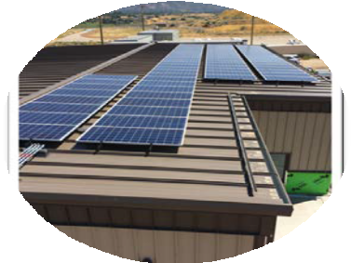
Effective Policy Solutions & New Strategies
Encourage investments in data and technology
Real-time monitors
Enhancing customer experience
Smart irrigation controllers and leak detection devices
Financing (SRECs, etc) make projects more cost effective
(micro-turbines, solar, wind, bio-energy, energy-neutral WWTPs)
Energy portfolio diversification and optimized water storage provides efficiency and resiliency
Infrastructure Replacement Surcharges
Expand electric utility rebates to help fund efficiency improvements

Slide 15
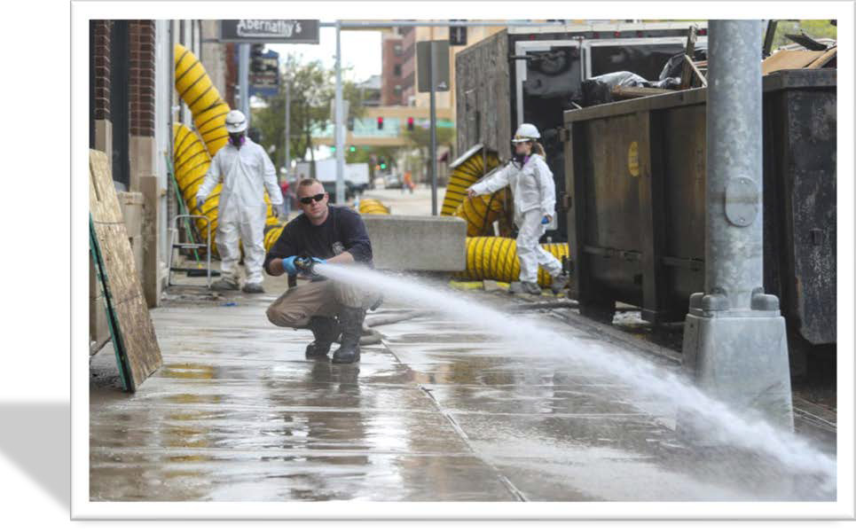
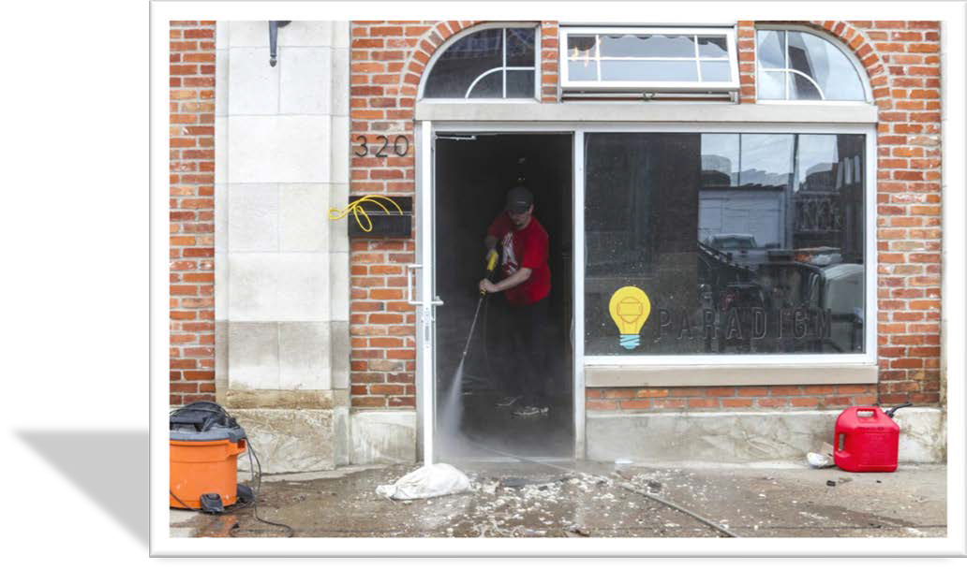
Conclusion: Water Service should be available 24/7/365 Before, During and After Events.
QCTimes.com May 2019
4th National Climate Assessment: Compound extremes can also increase the risk of cascading infrastructure failure since some infrastructure systems rely on others, and the failure of one system can lead to the failure of interconnected systems, such as water–energy infrastructure (Ch. 4: Energy; Ch. 17: Complex System

Slide 16


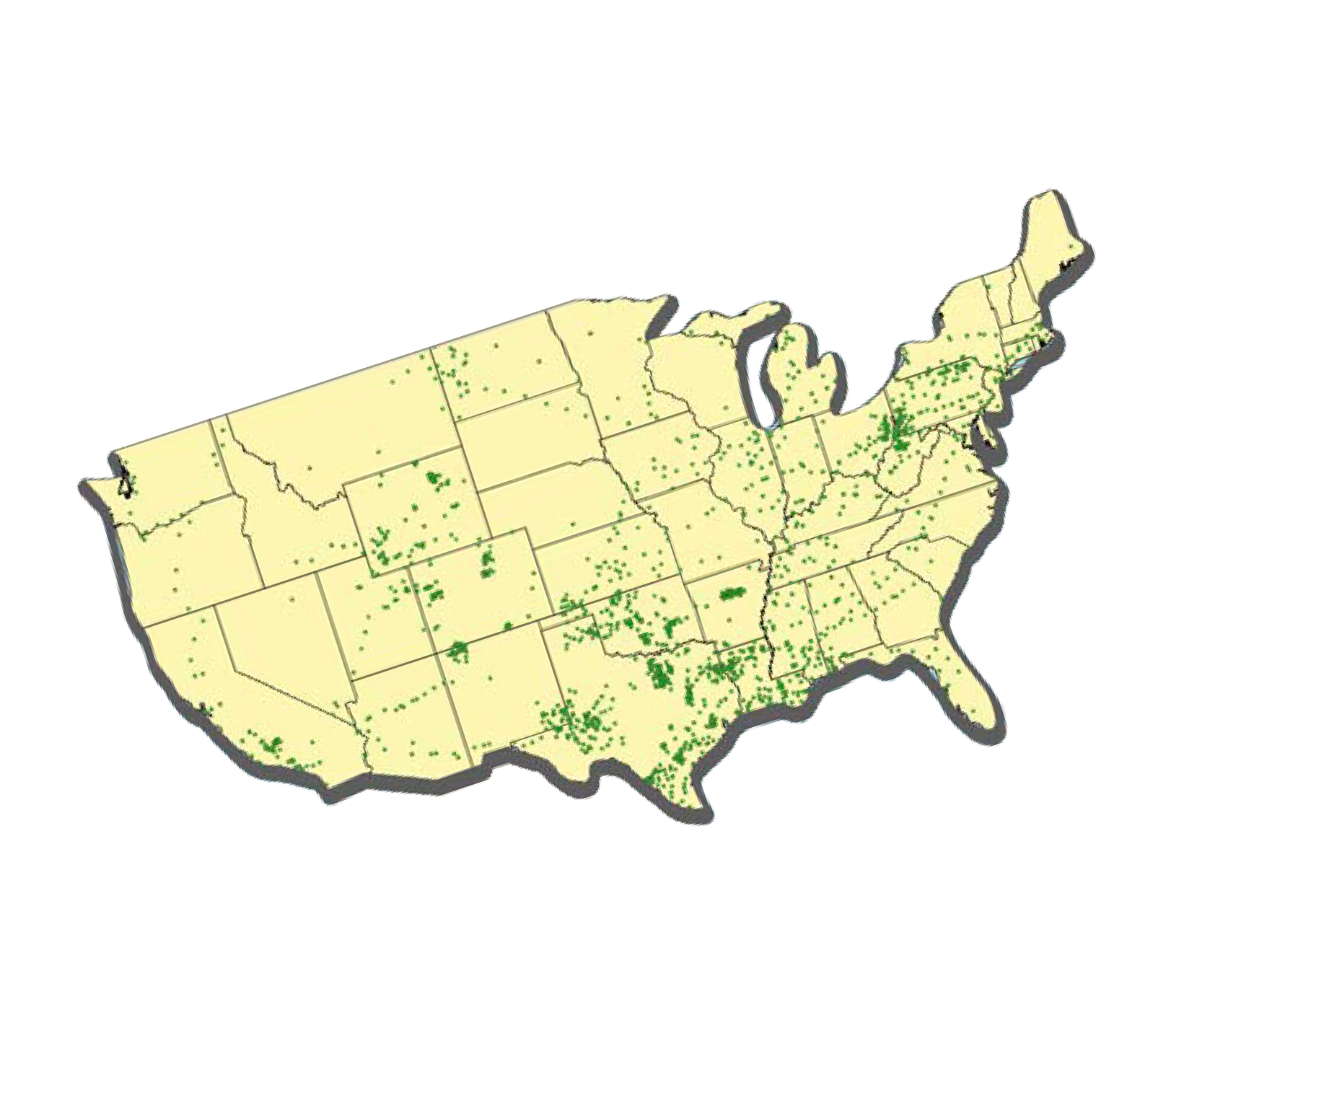



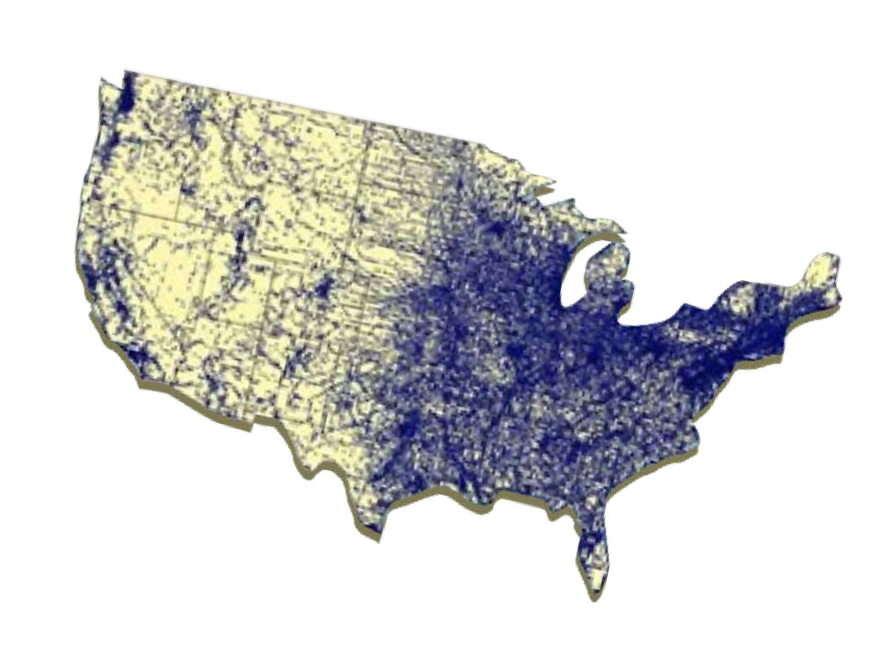

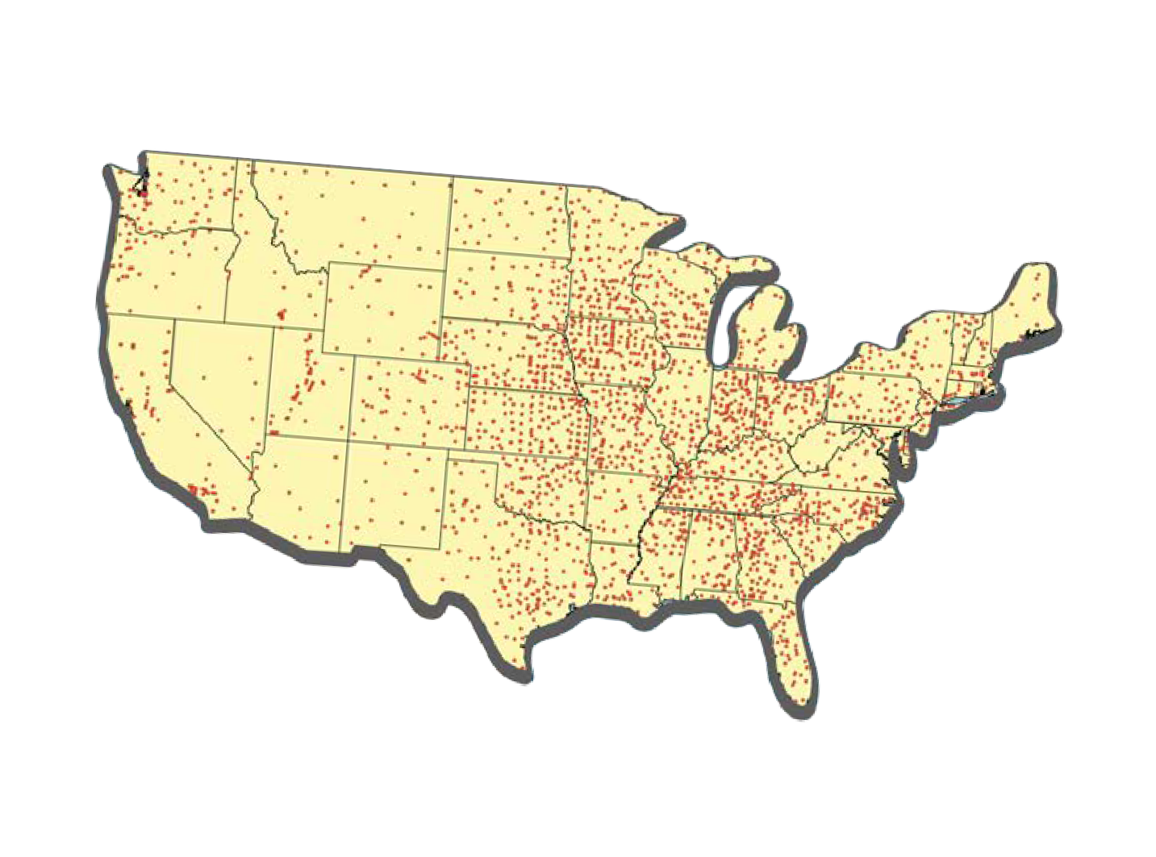







Compound extremes also increase the risk of cascading infrastructure failure
Gas Utilities Source: EPA F.L.I.G.H.T. Greenhouse Gas Emissions from Large Facilities Ghgdata.epa.gov/ghgp/main.do#
Electric Utilities Source: Form EIA-861 detailed data files www.eia.gov/electricity/data/eia8
Water Utilities Source: EPA SDWIS Federal Reports Search www3.epa.gov/enviro/facts/sdwis
4

Slide 17


Suzanne Chiavari
Director-Engineering: Treatment & Resiliency American Water
Camden, NJ
Suzanne.Chiavari@amwater.com 856.955.4272
THANK YOU

Slide 18

The Water-Energy Nexus; Building Resiliency, Safety, and Reliability
Catherine J.K. Sandoval,
Associate Professor, Santa Clara University School of Law Former Commissioner,
California Public Utilities Commission
AABE Water-Energy Nexus Webinar, February 26, 2020

Slide 19



The Water/Energy Nexus, Defined
The Embedded Water In Energy
Water is used throughout the Energy Lifecycle
Water may be used for Energy resource extraction, e.g. in fracking
Water may be used in Energy resources production, e.g. some water is used in solar panel production and to keep solar panels clean
Water is in thermal power plants for Energy Generation; water is converted to steam to turn a turbine; water is used for cooling
Water affects Energy resource maintenance, e.g. drought may compromise trees near power lines
Embedded Energy in Water Energy is used throughout the Water and Wastewater Lifecyle
Energy may be used in Water extraction, e.g. in groundwater pumping
Energy is used in Water treatment
Energy may be used in Water conveyance, e.g. water projects that convey water in aqueducts, particularly when water must travel up hill
Energy may be used for Water Storage and Pumping for after treatment
Energy may be used in Water Distribution
Energy may be used to Heat Water
Energy is embedded in Cool Water
2

Slide 20


Water may be used for Energy resource extraction or harnessing, e.g. in fracking or for geothermal productivity
Water may be used in Energy facilities production, e.g. some water is used in solar panel production and to keep solar panels clean, water is used in steelmaking for energy facilities
Water is used in thermal power plants for Energy Generation as water is converted to stem for a Geothermal, Natural Gas, Coal, or nuclear plant, and water is used for cooling
Water is the “fuel” for hydroelectric power production, source for hydrogen, and used to produce ethanol and many biofuels
Water affects Energy resource maintenance,
e.g. drought may compromise trees near
power lines
Water in Energy
3

Slide 21

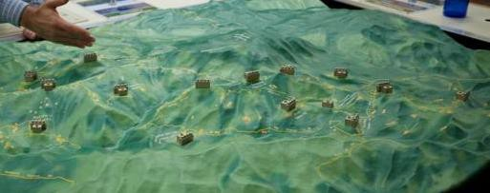
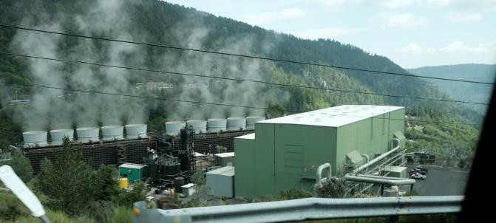
Energy Systems Use Water to:
Water in Energy
Extract or Harness Energy
Manufacture Energy Facilities
Generate Water for Steam in Thermal Plants Generate Water for Steam Heat
Cool Water Used in Thermal Plants Maintain Facilities, e.g. dust buildup management, clean solar panels
Drought affects Vegetation management and Fire Hazards
4
CalPine Geothermal Power Plant

Slide 22


Energy in Water
Energy Facilities Manufacturing
Energy Extraction or Harnessing
Thermal Power Production
Collect Water
Water Recycling and Production
Transfer Water
Energy Appliances and storage, e.g. Evaporative Coolers, Hot Water Heaters
Hydro, Biofuel, Hydrogen Production
Vegetation, Distribution, and Transmission Management
Energy Facilities Maintenance
Treat Water
Wastewater Treatment
Water in Energy
Graphics by Professor Catherine Sandoval
Water Uses, Household, Business, Industrial, Agricultural
Pump and Store Water
5

Slide 23

Saving Water Saves Energy
Energy Efficiency Measures can be applied to Water/Energy Nexus uses:
Hot Water Energy Efficiency Measures, e.g.
High Efficiency Clothes Washer / Water Heater Blanket / Low Flow Shower Heads / Water Heater Pipe Insulation / Faucet Aerator / Water Heater Repair/Replacement / Thermostatic Shower Valve
Cold Water Measures Save Energy Too!
Toilets & Water Efficiency Facts
Toilets utilize ~ 30% of all indoor water (treated water) Old Toilets use 5-7 Gallons of Water/Flush
New Low Flow High Efficiency Toilets use 1–2 Gallons/Flush
Leaky Old Toilets can use 200+ gallons of water/day! Running Toilets can use 2000 gallons of water/ day!!
Taps & Appliances Water Efficiency Facts Leaky Taps wastes water
Measures available to reduce waterflow for taps and showerheads Leaky Hot Water Heater wastes water and energy
Turf and Outdoor Water Use ~ up to 60% of all home water use
Outdoor water use can = 60% of residential water use in summer
Pools can consume up to ~ 30,000 gallons of water a year for filling and due to evaporation
6

Slide 24
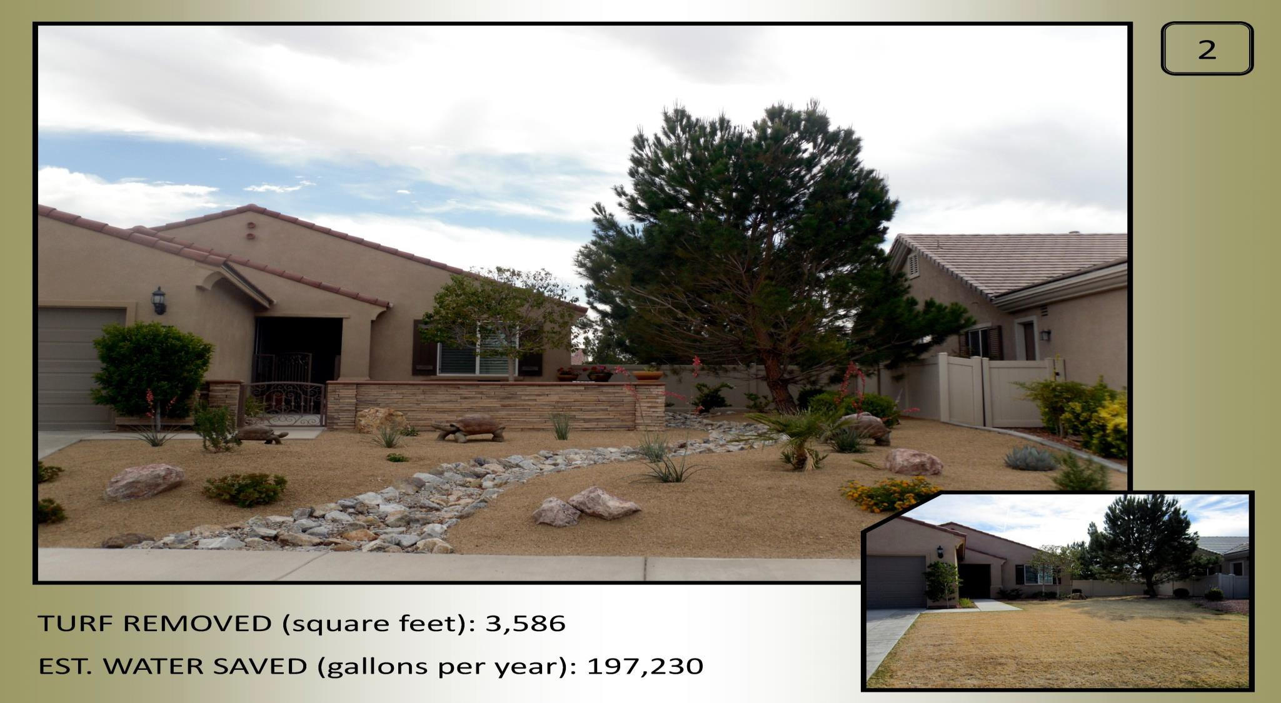
Water-Savings Measures such as Turf Reduction Saves Energy used in Water Pumping and the Water Extraction and Treatment Process

Slide 25
Regulatory, Community, and Industry Leadership Can Address the Water/Energy Nexus
State and federal regulators can initiate proceedings to examine and address the water/energy nexus
Innovators and business can address the water/energy nexus through innovation, investment, business practices that recognize the nexus, reduce water and energy use, and support for proceedings and programs
Community support is critical, e.g. smart water use and conservation, particularly during drought
Climate change makes action imperative

Slide 26
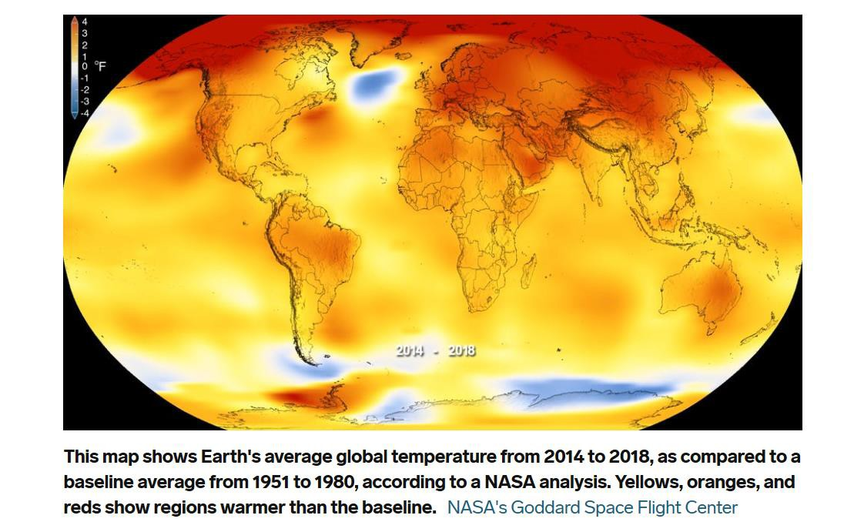
Climate Change Creates New Water/Energy Nexus Challenges
Temperatures are Projected to Rise in Many Areas of the United States
Business Insider, Nov. 22, 2019, https://www.businessinsider.com/climate-change-in-the-next-decade-2019-11#regardless-of-what-actions-we-take-there-are-a-few- changes-scientists-know-well-see-in-the-next-10-years-5

Slide 27
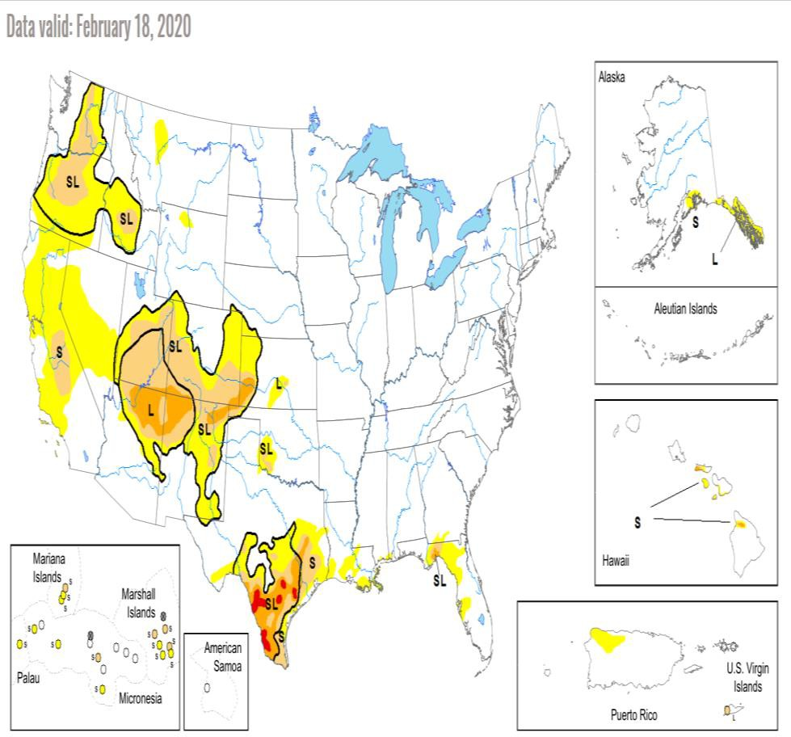
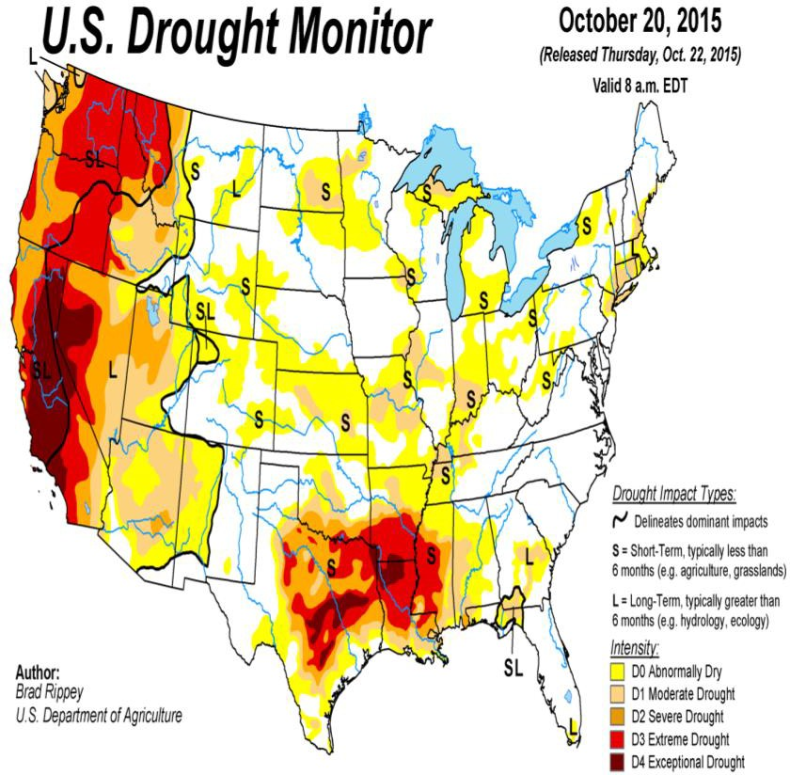
Many Areas of the United States Often Face Drought Affecting Water Resources and Energy;
Proactive Planning Required

Slide 28
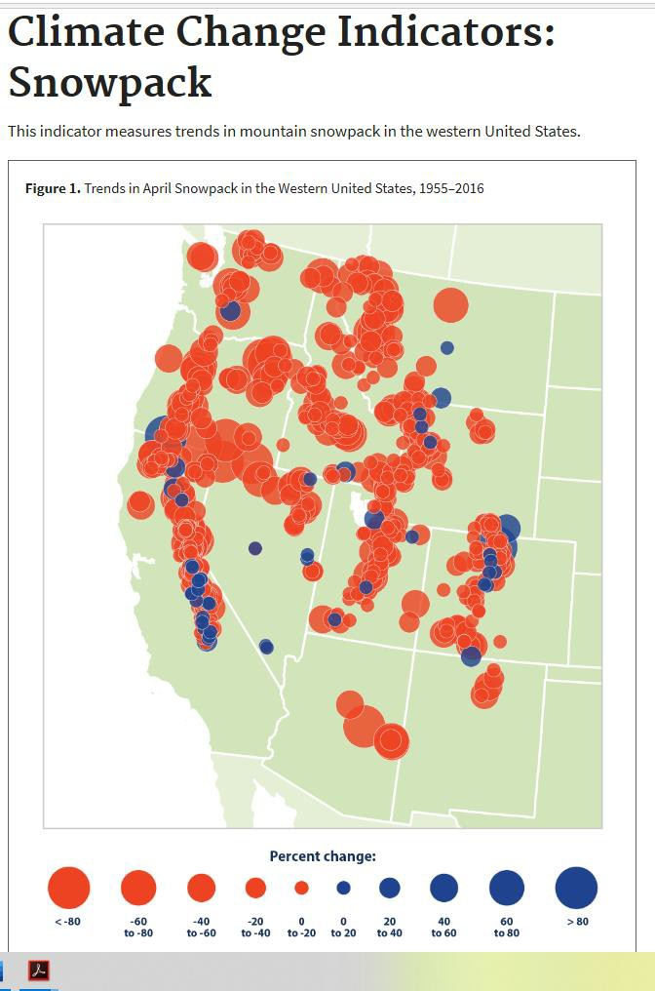
Declining Snowpack Reduces Water Resources
Diminishes Water Available for All Uses including Energy
U.S. EPA, Snowpack Changes,
1995-2016

Slide 29
California Public Utilities Commission (CPUC) Water/Energy Nexus
Proceeding, R.13-12-011
CPUC Water Energy Nexus Proceeding adopted four decisions while Commissioner Catherine Sandoval served as Assigned Commissioner:
Cost Calculator, Calculating the embedded electric energy in water:
https://www.cpuc.ca.gov/nexus_calculator/
Advanced Metering Infrastructure Piggybacking Pilots; Allowing Water Utilities to partner with Electric Utilities Advanced Meter Infrastructure
Matinee Pricing Pilots, Testing Pricing Models that attract commercial, industrial, and agricultural customers to mid-day energy use
Communications/Water/Energy Nexus; identifying communications lines with poor performing circuits that affect water and energy IOUs, high- wildfire-risk communications gaps; opportunities to use Information and Communications Technologies to address the Water/Energy Nexus, improve resiliency, reliability, safety, and promote just and reasonable rates

Slide 30

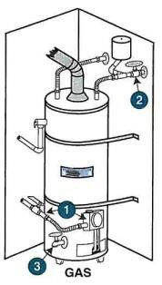
CPUC Low Income Energy Efficiency Savings Program approved measures to address the Water/Energy Nexus for low-income ratepayers
CPUC approved Water/Energy Nexus measures for common areas of buildings that house a majority of low-income tenants
CPUC Balanced Rates Order Instituting Rulemaking Directed Large Water IOUs to Evaluate whether Advanced Meters would Promote Reliability, Safety, and Just and Reasonable Rates in their Service Territory and, if so, to apply in the General Rate Case
Advanced Water Meters can quickly detect water usage that wastes water and energy, e.g. leaky hot water heaters, leaky faucets or hoses.
Prompt detection of unusual water use patterns save water and energy and prevent backflow incidents that can compromise water safety.
CPUC Water/Energy Nexus
Proceeding Led to
Adoption of Measures and Programs to Address the Water/Energy Nexus, Saving Water, Energy, and Limiting Greenhouse Gas (GhG) Emissions

Slide 31
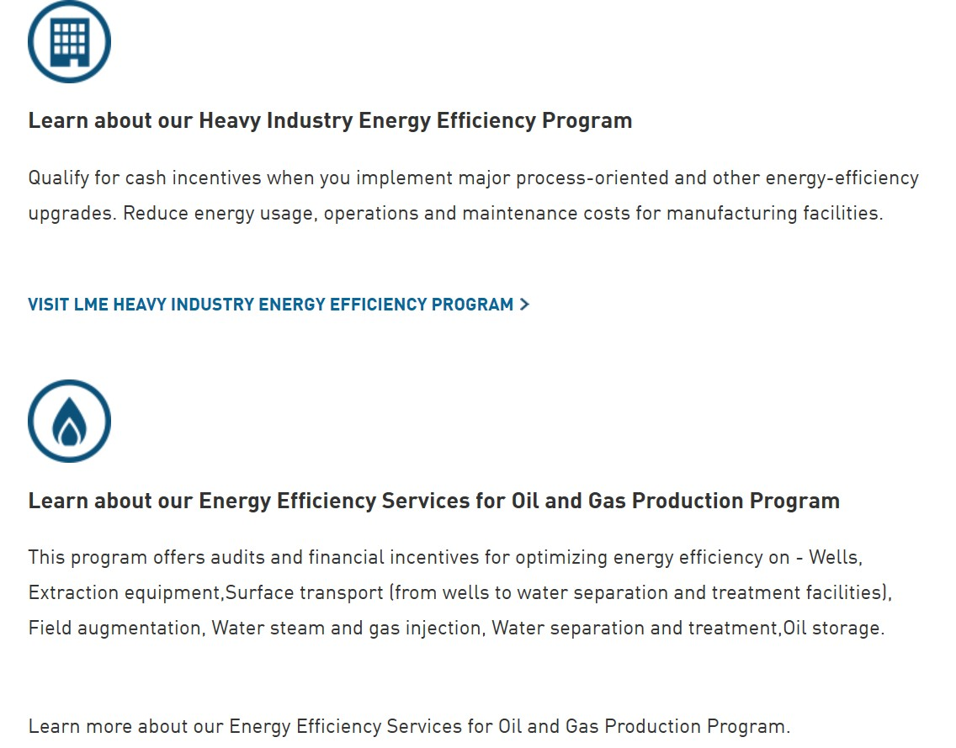
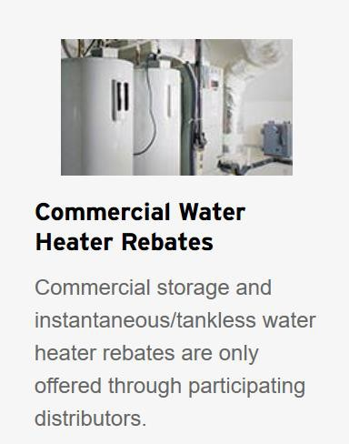
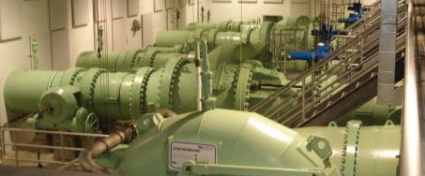
Industrial Customers including Oil and Gas Production, e.g. PG&E, SCE, SDG&E, SoCal Gas, and Small Energy IOU Programs Authorized by the CPUC
Energy Efficiency Programs Address Water/Energy Nexus for
Energy Audits Help Water Utilities Save Energy,
SDG&E
Partnership with
San Diego County Water Authority
Commercial Water Heater Rebates Promote Natural Gas and Water Efficiency

Slide 32
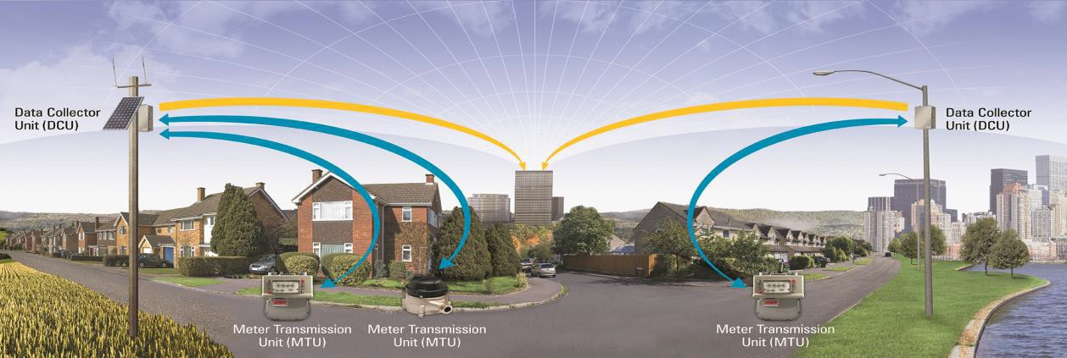
CPUC Water-Energy Nexus AMI/ “Piggybacking” Pilots; CPUC Decision 16-06-010 (Catherine Sandoval, Assigned Commissioner),
Deploying Communications Infrastructure to Save Water and Energy
*The Shared Network Pilot authorized by the CPUC in 2016, is a partnership between SoCalGas, Aclara and
participating water utilities to evaluate the concept of a Shared Network on a small scale.
*AMI can quickly identify abnormally high gas usage, enabling fast response to potential safety situations quicker. Energy and water are saved, and methane emissions at customer facilities are reduced improving air quality, reducing GHGs, and customer bills.
From the presentation by SoCal Gas and SDG&E, http://www.calwaterassn.com/wp-
content/uploads/2016/04/SoCalGas-Aclara-Valor-AWWA-March22ConferenceFinal.pdf

Slide 33
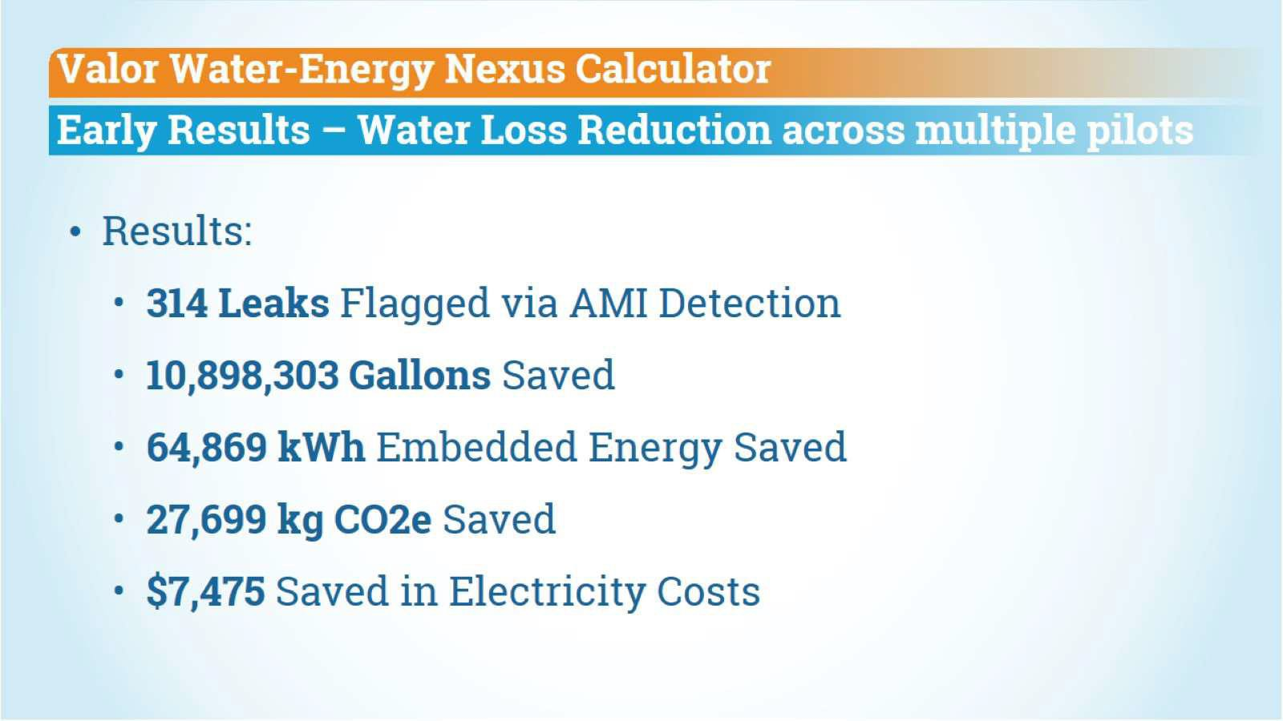
Water/Energy Nexus AMI Pilot Evaluation, Dec. 2017
Data presented by Christine Boyle, Valor Water Analytics, Dec. 2017: http://ca-nv-
awwa.org/canv/downloads/2017/30Boyle.pdf

Slide 34

Communications and the Internet of Things (IOT)
Increasing growth of internet-connected devices can produce energy
efficiency, demand response, and save water
Demand response can be critical to staving off blackouts when energy resources are low, such as due to the Aliso Canyon gas field issues that led to a shortfall of natural gas availability to run power plants in the Los Angeles area
California Utilities in 2016 were able to send signals to Air Conditioner compressors to slow down by 50% of turn off to save energy, for households that opted into the program
Saved 300 MW of Power on demand, equivalent to an Energy Peaker Plant
The Communications/Water/Energy Nexus Increases Visibility, Reliability, Dispatchability to Promote Service Reliability, Safety, and Just and Reasonable Rates

Slide 35
Engage People to Develop Policy and Promote Sustainability
Public Engagement is Critical to Water and Energy Conservation
Regulatory Leadership can Create New Opportunities to Address the Water/Energy
Nexus in a Changing Climate
Innovation, Research, Investment, Business, Academic, Government and Community Leadership are needed to address the water/energy nexus
Public
Engagement
Regulatory
Leadership
Water/Energy Nexus Policy Development and Administration
Innovation, Research, Investment, Business, Academic, Government and Community Leadership
18

Slide 36
Thank you!
Catherine Sandoval Associate Professor
Santa Clara University School of Law Csandoval@scu.edu
See Professor Sandoval’s SCU Law Faculty Page for More Information about Her Recent Scholarship:
https://law.scu.edu/faculty/profile/sandoval-catherine/

